Slide 1


Human Mobility x Invasive Species Networks, Mobility, and Nationwide Prevention
Cuebiq Hackathon
24 March 2021
Presenter: Collin Schwantes
Daniel Duong
Arjun Saravanan
Marjorie Willner
Tracey Zhai

Slide 2


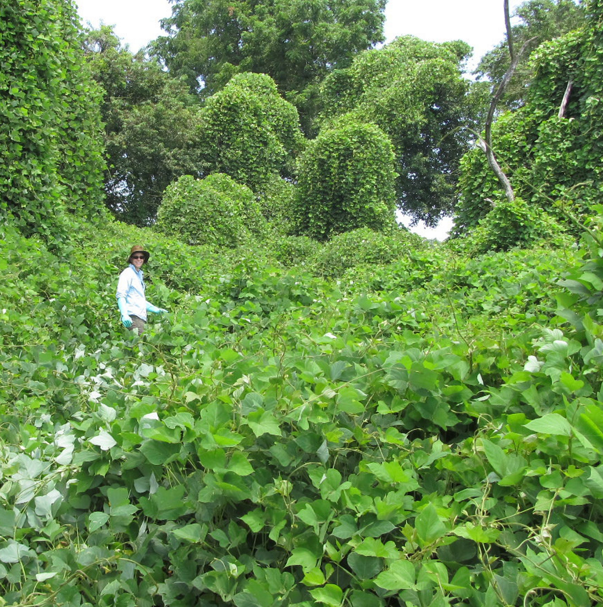
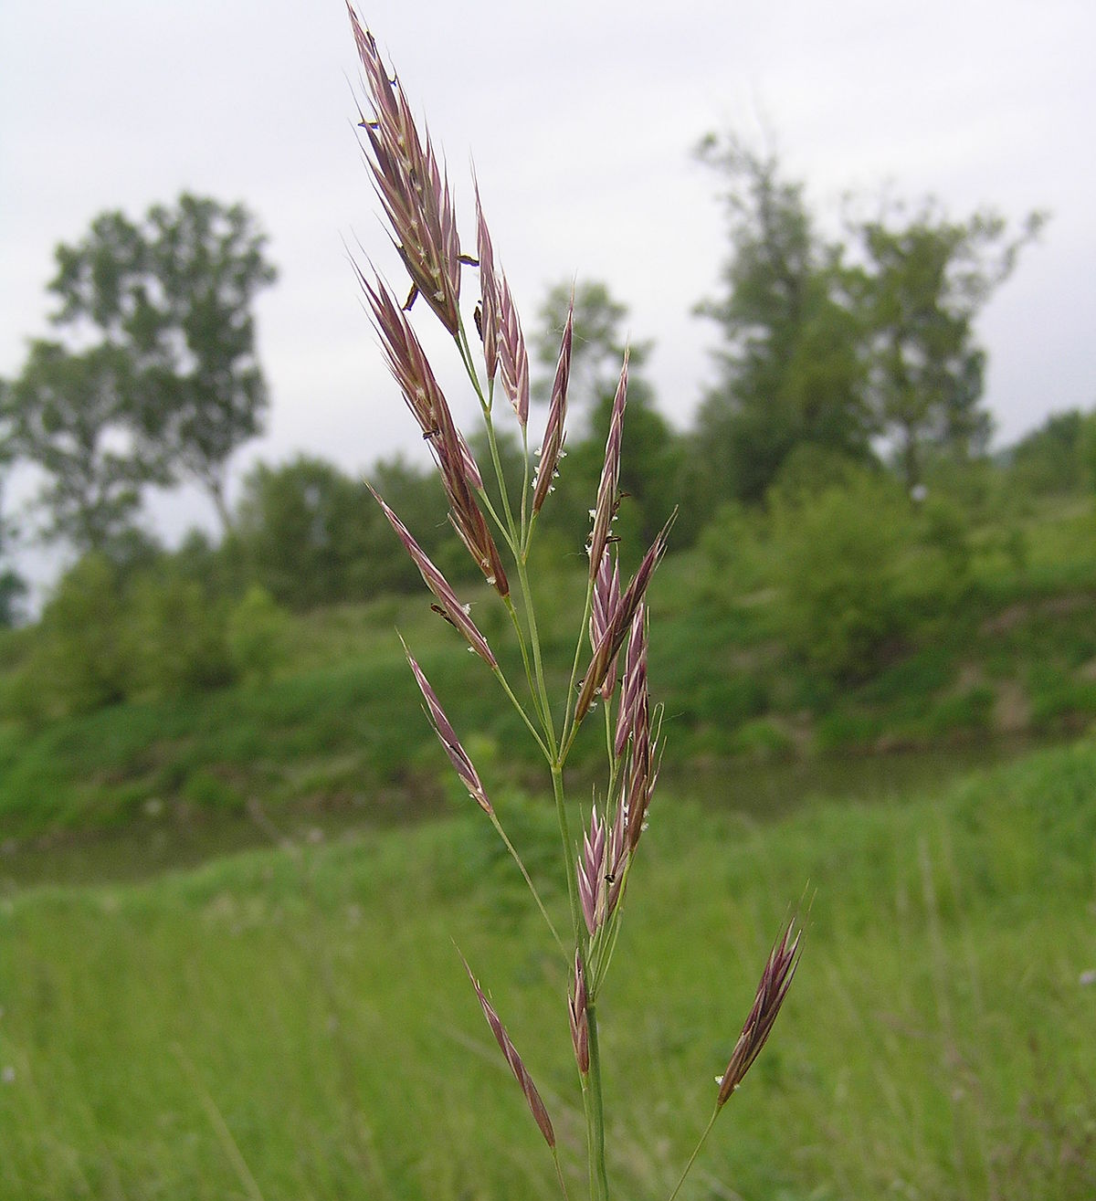
Motivation
The spread of invasive species is a major factor contributing to undesirable landscape level change and ecological instability in national parks
Cheat Grass – increases fire hazard
Quagga mussels – choke marine infrastructure
Nutria - undermine levees and dams
Kudzu – Smother forests in southeastern US
Notes:
Invasive species can have dramatic impact on infrastructure and ecosystems
https://www.doi.gov/sites/doi.gov/files/uploads/invasive_species_impacts_on_infrastructure.pdf
Invasive animals and plants cause serious damage.

Slide 3


Background
What are invasive species?
Alien species whose introduction causes or may cause economic or environmental ruin
What impact have invasive species had on our environment?
As of 2017, over 1.4 million acres of national park units were infested with invasive species, of which only 43,000 acres are controlled
Over 400 of the 1,300 species protected by the Endangered Species Act are at risk partly because of competition, predation, and displacement by invasive species
Notes:
CostofInvasivesFactSheet.pdf (fws.gov)

Slide 4

Economic Impact
Federal expenditures on invasive species are estimated to exceed $1.3 billion annually
USDA estimates that invasive species cause $137 billion dollars per year in economic loses
In FY2020, the Department of the Interior invested $143 million to manage invasive species
The National Parks Service spends $12 million annually on invasive species control
Notes:
https://nifa.usda.gov/program/invasive-species-program
https://www.doi.gov/pressreleases/trump-administration-outlines-comprehensive-strategy-tackle-120-billion-problem
https://www.doi.gov/sites/doi.gov/files/doi-invasive-species-strategic-plan-2021-2025-508.pdf
http://dnrc.mt.gov/divisions/cardd/docs/misac-docs/econ-press-release_final.pdf
https://irma.nps.gov/DataStore/DownloadFile/603582

Slide 5
Prevention and Early Response
"As stated in Executive Order 13751, NPS should participate in technological innovation to control and prevent invasive species. NPS could partner with other government agencies, academic institutions, non-government organizations, and for-profit entities that are actively engaged in development of new technologies and approaches to invasive animal management."
USDA and DOI are actively looking for early detection systems
ML-Enhanced invasiveness risk models
Maritime trade and travel monitoring
Environmental DNA for early detection
Notes:
Reduced spend on active engagement to fight invasive species

Slide 6
Scope: National Parks
Scope
Detection
Prevention
We prioritized national parks for our proof of concept because they have well defined area and limited human activity
Plant invasion is almost entirely dependent on people or animals moving plants for initial establishment
Using human mobility data, we can uncover hidden networks among national parks, giving insight on potentially invasive species outside of their immediate regions
Identifying and monitoring novel foot traffic patterns between parks is a crucial first step in preventing spread and economic losses related invasive species control
Notes:
Application approach
Focusing on national parks

Slide 7
Invasion Through the Paths Less Traveled
Identifying common mobility patterns across national park lands during different seasons of the year can be critical for mitigating social, economic, and environmental risks of invasive species introduced unintentionally through human travel
Notes:
https://nifa.usda.gov/program/invasive-species-program
https://www.doi.gov/pressreleases/trump-administration-outlines-comprehensive-strategy-tackle-120-billion-problem
https://www.doi.gov/sites/doi.gov/files/doi-invasive-species-strategic-plan-2021-2025-508.pdf
https://irma.nps.gov/DataStore/DownloadFile/603582

Slide 8
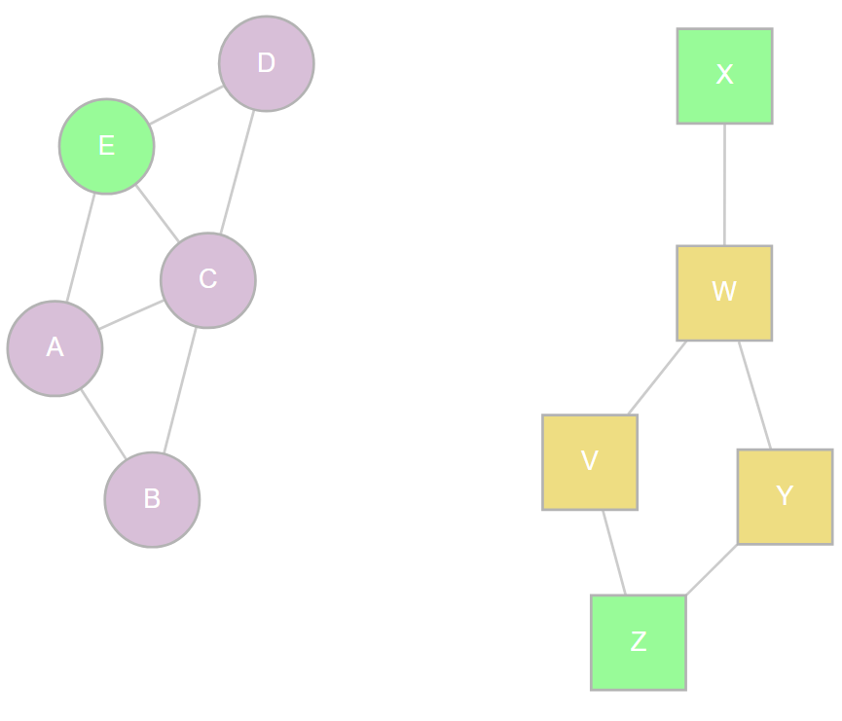
Hypothesis
Spatial representations of regional networks do not entirely show connectivity
Notes:
Currently the national parks system uses a regional approach to controlling

Slide 9
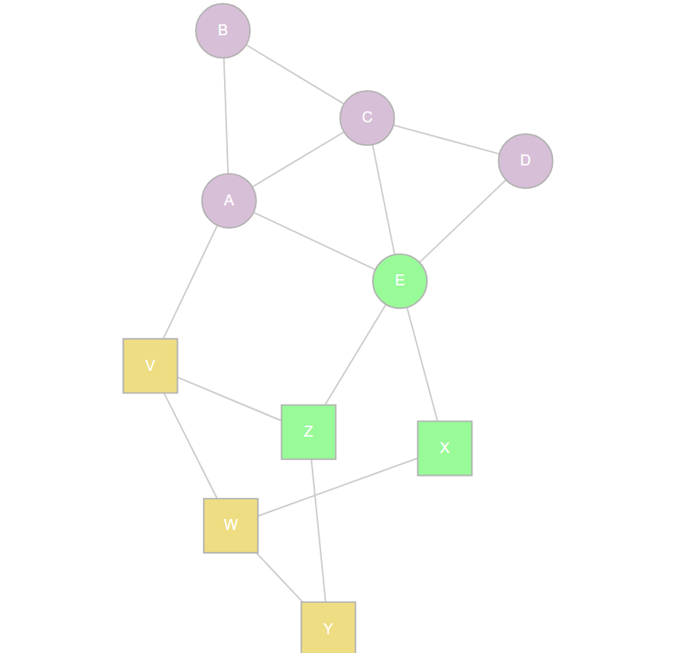
Hypothesis
Regional networks will ​ become highly connected ​ as we add mobility data​
Connection between similar​ habitats and possible invasion​

Slide 10
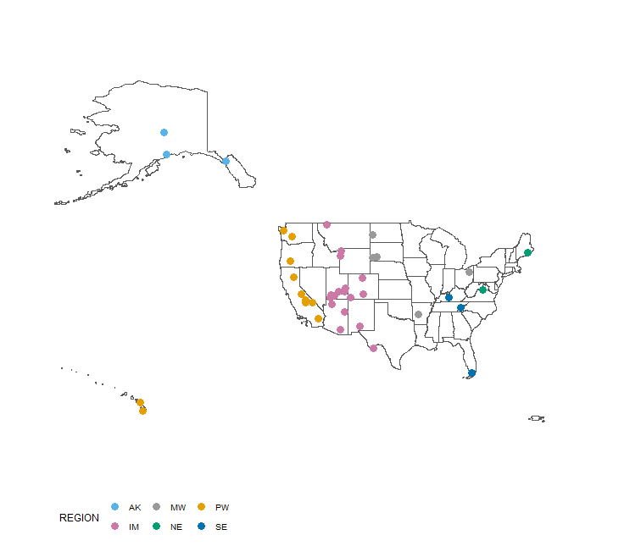
Park Selection
Parks with the most visitors (upper quartile) as reported by NPS

Slide 11
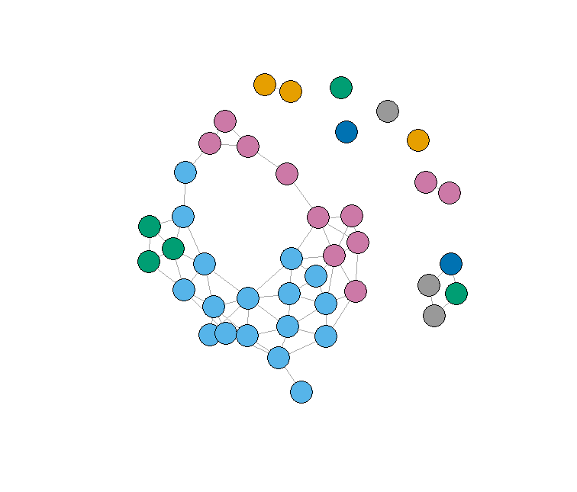
Spatial Network of Parks
Used Voronoi polygons to establish neighborhoods
Removed edges if distance between parks is greater than 400 miles
Expect to see greater connectivity between larger regions after adding mobility data

Slide 12
Data & Methodology
Dataset
Timeframe Analyzed
January 1st to December 31st 2019
Geo Specs
Mapped across 41 national parks
Approach
Created a graph network, with parks as nodes and connections as movement between parks
Identified a weight baseline (number of connections between nodes), prioritizing connections that have a higher weight
Performed analysis of high strength weights for potential spread of invasive species

Slide 13
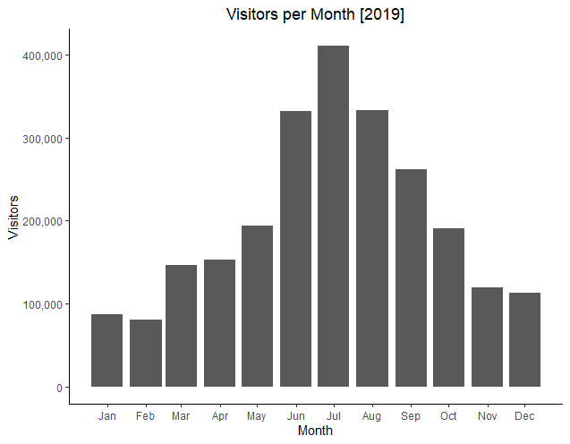
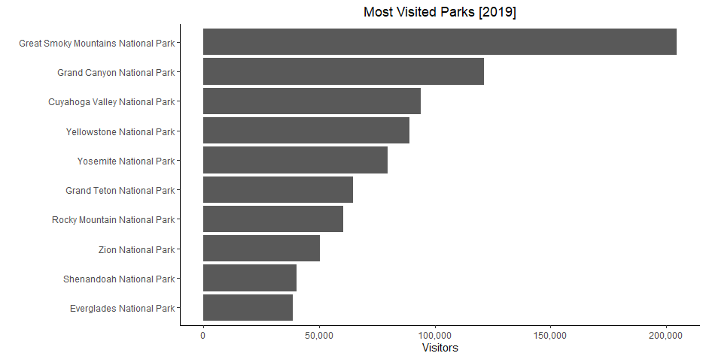
Mobility Data – Data Exploration
Great Smoky Mountains and Yellowstone are the most visited parks
National Parks receive the most visits during summer months

Slide 14
Findings
Average weight: 12 connections per national park
The model confirms mobility between national parks in similar as well as dissimilar habitats and geographical location
Example: Everglades National Park <-> Grand Teton National Park
Focusing on the weight of each connection can help determine the effort needed to prevent invasive species from spreading
Highest-weighted edges:
1.) Grand Teton National Park -- Yellowstone National Park
2.) Bryce Canyon National Park -- Zion National Park
3.) Grand Canyon National Park -- Zion National Park
Notes:
Looking at edge weights we find that closer parks have more visitors moving between them, not unexpected,

Slide 15
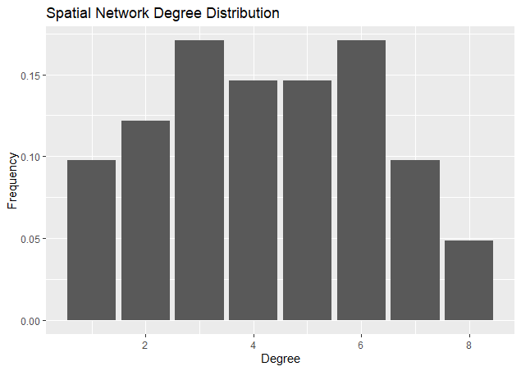
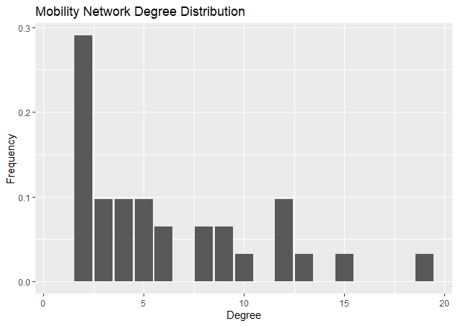
Findings
*Degree distribution for parks with an edge weight greater than 1000
Notes:
But when we look at the overall network, we see very different degree distributions.

Slide 16
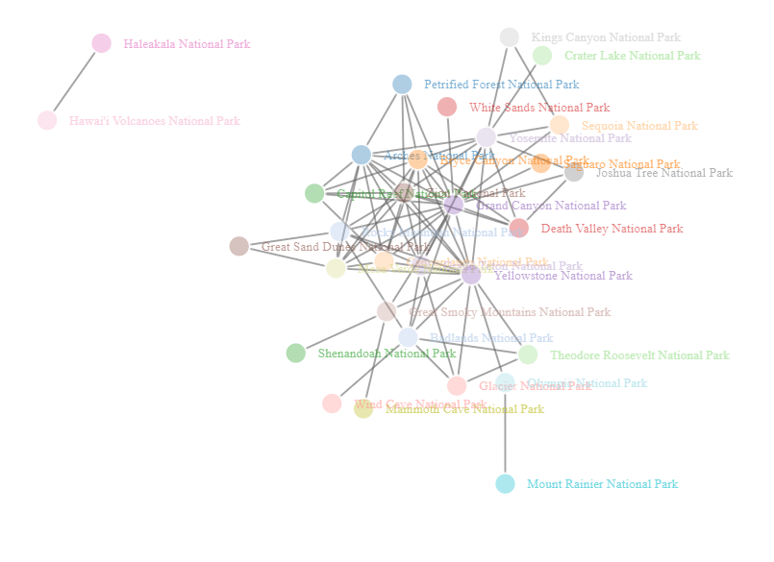
Findings
Network Structure
is very different between
spatial and mobility based
networks.
Notes:
But when we look at the overall network, we see very different degree distributions.

Slide 17
Conclusion
Understand mobility patterns of humans to track spread of invasive species across parks and protected lands
Build out regional, state-wide, and park-level recommendations for park staff and travelers
Identify risks and prioritize budget for creating a targeted spend plan on controlling invasive species
Notes:
Utilizing a mobility model, we can

Slide 18
Questions?

Slide 19
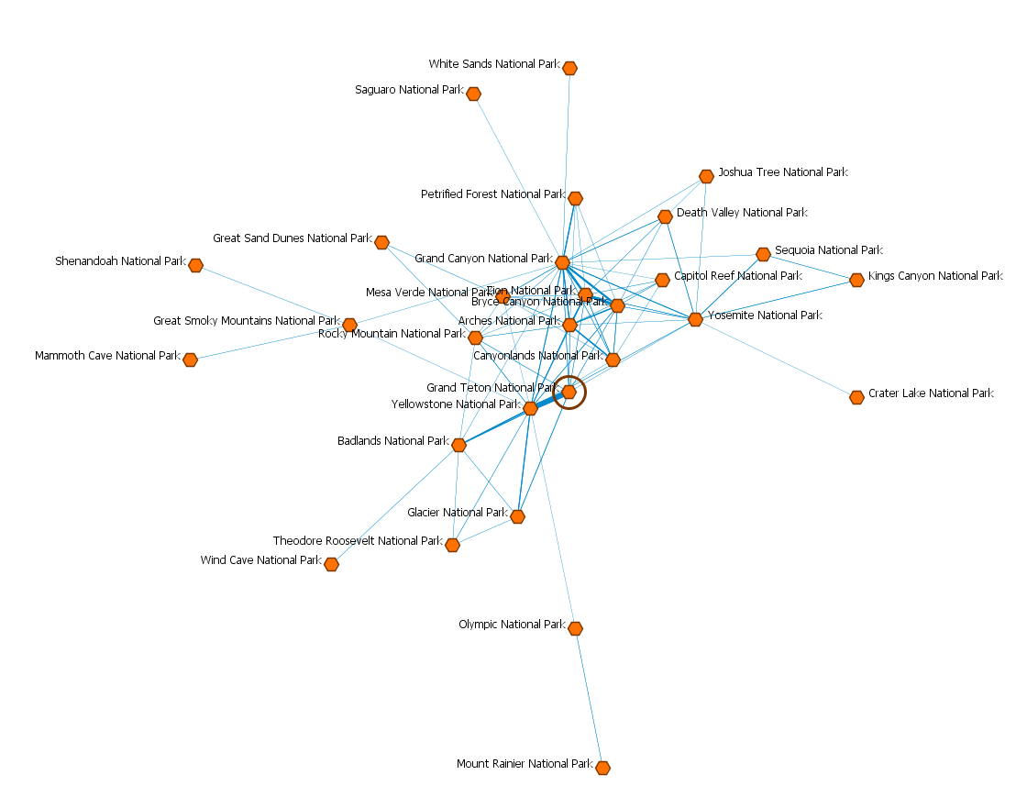
> 1000 links

Slide 20
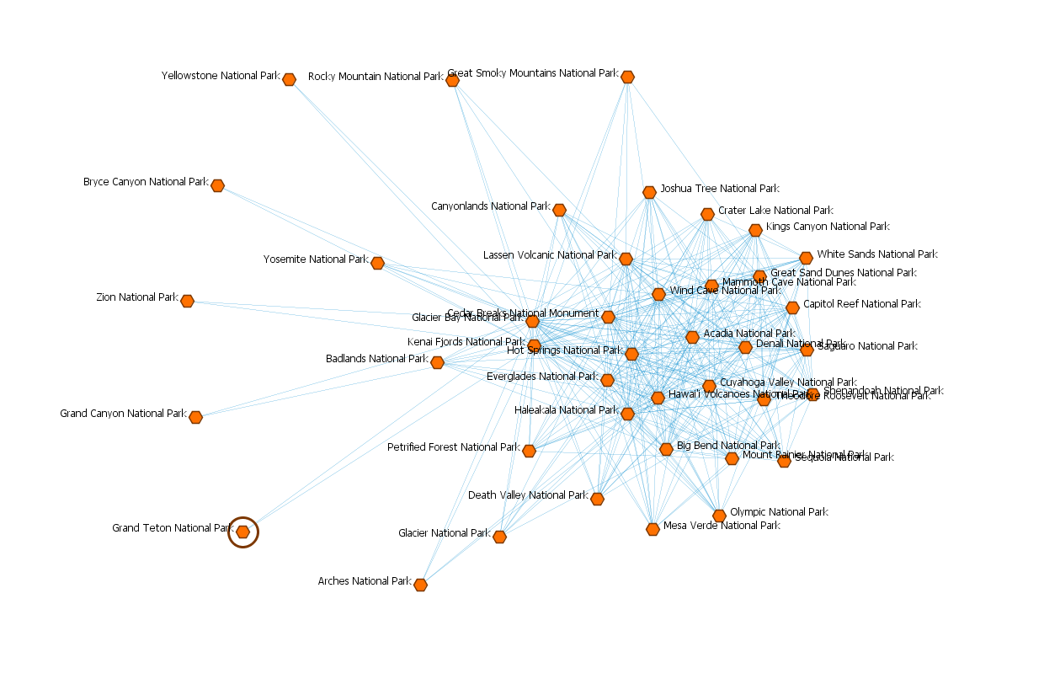
> 200 Links

Slide 21
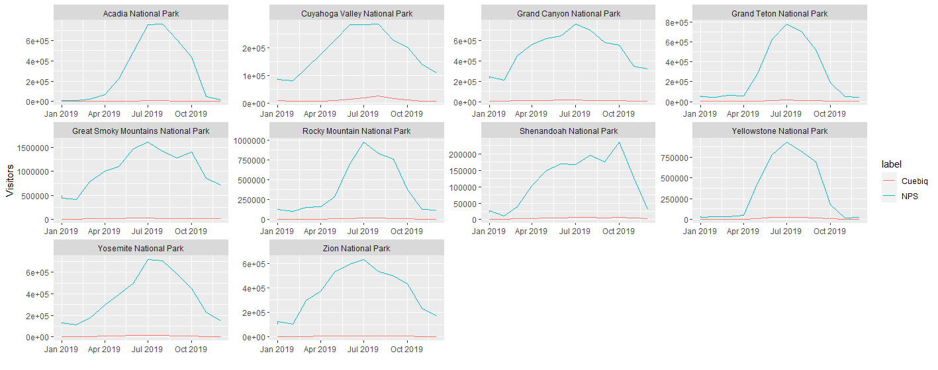
Cuebiq Visits vs. NPS Visits

